Slide 1

SMART WASTE-AI-POWERED COMMUNITY WASTE MANAGEMENT SYSTEM
TEAM DETAILS
NAME: AKSHAYALAKSHMI / 211423104026 NAME: DEEPIKA M / 211423104111
BATCH NUMBER : A1
DOMAIN: ARTIFICIAL INTELLIGENCE
MRS. K. CINTHUJA, M.E ASSISTANT PROFESSOR
DATE : 30/10/2025
COORDINATOR NAME & DESIGNATION
DR.KAVITHA SUBRAMANIAM PROFESSOR

Slide 2



SDGs and TARGETs
Primary Goal No: SDG 12 – Responsible Consumption and Production
🎯 Target 12.4:Ensure environmentally sound management of chemicals and all wastes throughout
their life cycle
🎯 Target 12.5:Substantially reduce waste generation through prevention, reduction, recycling, and
Reuse
Secondary Goal No: SDG 11 – Sustainable Cities and Communities
🎯 Target 11.6:By 2030, reduce the adverse per capita environmental impact of cities, including by
paying special attention to air quality and municipal and other waste management
3.Tertiary Goal No: SDG 3 – Good Health and Well-Being
🎯 Target 3.9:By 2030, substantially reduce the number of deaths and illnesses from hazardous
chemicals and air, water, and soil pollution and contamination

Slide 3
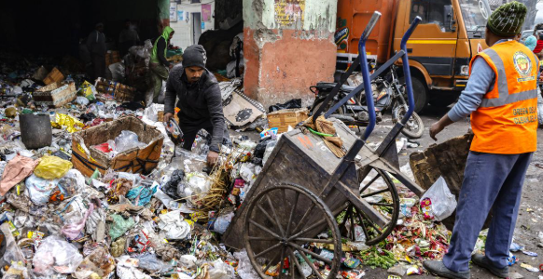
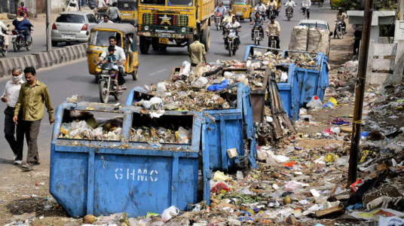
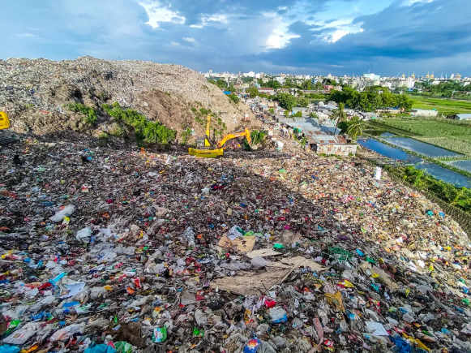
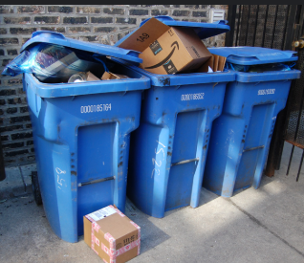
PROBLEM STATEMENT
Rapid urbanization has led to excessive waste generation.
Improper segregation (bio/non-bio waste) at the source.
Overflowing bins, delayed municipal responses.
Citizens lack tools to report issues or get tips.
No system to promote or reward eco-friendly ideas.
Existing systems are not AI-integrated or community-driven.

Slide 4
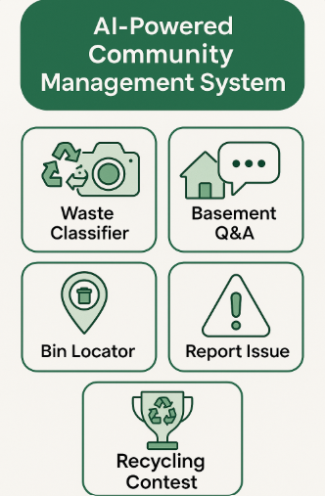
ABSTRACT
Problem & Purpose : Rapid urbanization has led to poor waste management, improper segregation, and delayed municipal responses. Citizens lack tools to identify waste types or report issues. This project aims to solve these problems by providing a smart, AI-based platform that ensures cleaner surroundings and promotes responsible community involvement in waste handling.
Solution & Impact : The system features an AI chatbot to classify waste and offer disposal tips, a reporting module for complaints, and a space for idea sharing with rewards. It aligns with SDG 12, SDG 11, and SDG 3, encouraging sustainability, community participation, and environmental awareness through technology.

Slide 5
LITERATURE REVIEW
1. AI-Powered Waste Classification Using Convolutional Neural Networks (Chan and Kim, 2024) This paper proposed a CNN-based approach for automatic waste classification, achieving high accuracy in sorting different waste types using image datasets. Relevance to Current Study: It inspired the use of deep learning in the Smart Waste system for accurate waste segregation through image-based classification.
2. Integrating Artificial Intelligence for Sustainable Waste Management (Dao, 2025) The study discussed how AI technologies enhance the sustainability and efficiency of modern waste management processes. Relevance to Current Study: This concept supports Smart Waste’s integration of AI to promote eco-friendly and data-driven waste handling operations.
3. Smart Waste Management: A Paradigm Shift Enabled by AI-Driven Solutions (Olawade et al., 2024) This work highlighted how AI revolutionizes traditional waste systems by enabling smart bins, automated sorting, and real-time analytics. Relevance to Current Study: It guided Smart Waste’s approach to combining automation and community engagement for intelligent waste management.
4. Optimizing Waste Management Strategies through Artificial Intelligence (Alsabt et al., 2024) The paper presented AI-based optimization techniques for route planning, collection scheduling, and resource allocation. Relevance to Current Study: These optimization concepts influenced Smart Waste’s efficient route and collection management features.

Slide 6
LITERATURE REVIEW
5. Artificial Intelligence-Based Waste Management: A Review (Yevle and Mann, 2025) A comprehensive review summarizing recent AI models used for waste prediction, classification, and recycling optimization. Relevance to Current Study: This review provided insights that shaped SmartWaste’s AI framework for waste classification and predictive analytics.
6. AI-Driven Innovations in Waste Management (Snoun et al., 2025) The study explored emerging AI innovations enhancing automation, monitoring, and sustainability in waste systems. Relevance to Current Study: It reinforced the idea of continuous innovation adopted in SmartWaste’s intelligent monitoring module.
7. Leveraging Machine Learning for Sustainable Solid Waste (Subedi et al., 2025) This research implemented ML algorithms to analyze and manage solid waste efficiently for sustainable outcomes. Relevance to Current Study: It influenced SmartWaste’s application of ML for waste categorization and trend prediction.
8. Prediction of Waste Generation Using Machine Learning (Lee et al., 2025) Developed predictive models to estimate future waste quantities based on population and consumption data. Relevance to Current Study: Inspired SmartWaste’s predictive analytics component for proactive waste management planning.
9. Predicting Municipal Solid Waste Generation Using Artificial Intelligence (Nourani et al., 2025) This study used AI models to forecast municipal solid waste generation for strategic waste management decisions. Relevance to Current Study: It contributed to SmartWaste’s AI-based forecasting feature for improved urban waste planning.

Slide 7
LITERATURE REVIEW
10. Integrated BIM and Machine Learning System for Circularity Prediction of Construction Demolition Waste (Saka et al., 2024) This paper combined BIM and ML to predict material reuse and promote circular economy practices. Relevance to Current Study: Encouraged SmartWaste’s focus on sustainable reuse and recycling of collected waste materials.
11. A Heuristic for the Deployment of Collecting Routes for Urban Recycle Stations (Marseglia et al., 2025) Proposed a heuristic model to optimize collection routes and reduce operational costs in urban recycling. Relevance to Current Study: Formed the basis for SmartWaste’s intelligent route optimization for waste collection vehicles.
12. The AI-Powered Cleanup: A Revolution in Solid Waste (Tiwari and Pallavi, 2025) Outlined how AI can automate and revolutionize solid waste management for cleaner environments. Relevance to Current Study: Served as the conceptual foundation for SmartWaste’s AI-powered waste segregation and monitoring system.
13. Artificial Intelligence and IoT for Smart Waste Management (Fuqaha and Nursetiawan, 2025) The paper reviewed the integration of AI and IoT for real-time monitoring, highlighting challenges and opportunities. Relevance to Current Study: This inspired SmartWaste’s IoT-enabled smart bins for live waste tracking and data synchronization.

Slide 8
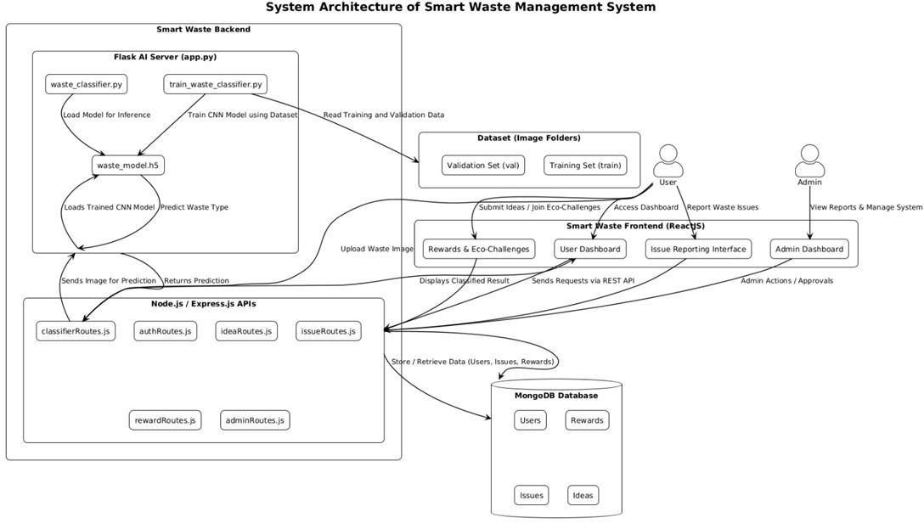
SYSTEM ARCHITECTURE DIAGRAM

Slide 9
ALGORITHM
1. Issue Reporting
This module allows users to directly communicate waste-related problems to municipal authorities. Users can capture and upload photos of garbage accumulation, missed collections, or overflowing bins, along with a short description and location. Once submitted, the complaint is automatically routed to the respective municipal department for action. Users can also track the complaint status in real time, ensuring transparency and accountability. This feature helps build community participation and ensures quicker waste issue resolution.
2. AI Chatbot (Waste Classifier)
The AI-powered chatbot serves as an intelligent assistant that helps users identify the type of waste—biodegradable, non-biodegradable, recyclable, or hazardous—by analyzing user input or uploaded images. It uses trained machine learning models to classify waste accurately and offers disposal tips or segregation instructions. The chatbot also educates users on best practices for waste management, making it both an interactive and educational tool for sustainability.
3. Waste Management Tips
This module acts as a knowledge and guidance section that provides personalized tips to users based on the kind of waste they handle. For instance, if a user reports organic waste, the system might suggest composting techniques, whereas for plastic waste, it could recommend nearby recycling points or reuse ideas. Tips are dynamically updated through AI learning and expert inputs, ensuring that users receive practical, relevant, and eco-friendly advice to minimize waste generation.

Slide 10
ALGORITHM
4. Idea Submission Portal
The idea submission portal promotes community engagement by encouraging users to share innovative solutions for reducing waste or improving sustainability. Each user can propose ideas, attach descriptions or visuals, and submit them for review. The municipal or app administrators evaluate these ideas, and selected ones are displayed on the community board. Users can also upvote or comment on others’ ideas, fostering collaboration. Outstanding contributions receive recognition or rewards, motivating active participation.
5. Admin Dashboard
The admin dashboard is designed for municipal officers and system administrators to efficiently manage the platform. It provides real-time access to complaint reports, user submissions, contest entries, and analytics. Admins can review and approve reported issues, update their resolution status, manage user-generated ideas, schedule contests, and analyze performance metrics such as participation rates or complaint resolution time. This central control panel ensures smooth coordination and data-driven decision-making.
6. User Profile & Rewards
Every registered user has a personal dashboard displaying their activity history, including complaints submitted, contests joined, ideas shared, and rewards earned. The reward system encourages consistent engagement through points, badges, and ranks based on participation. Users can monitor their contribution toward community cleanliness and view progress over time. This gamified reward tracking motivates responsible waste behavior and community involvement.

Slide 11
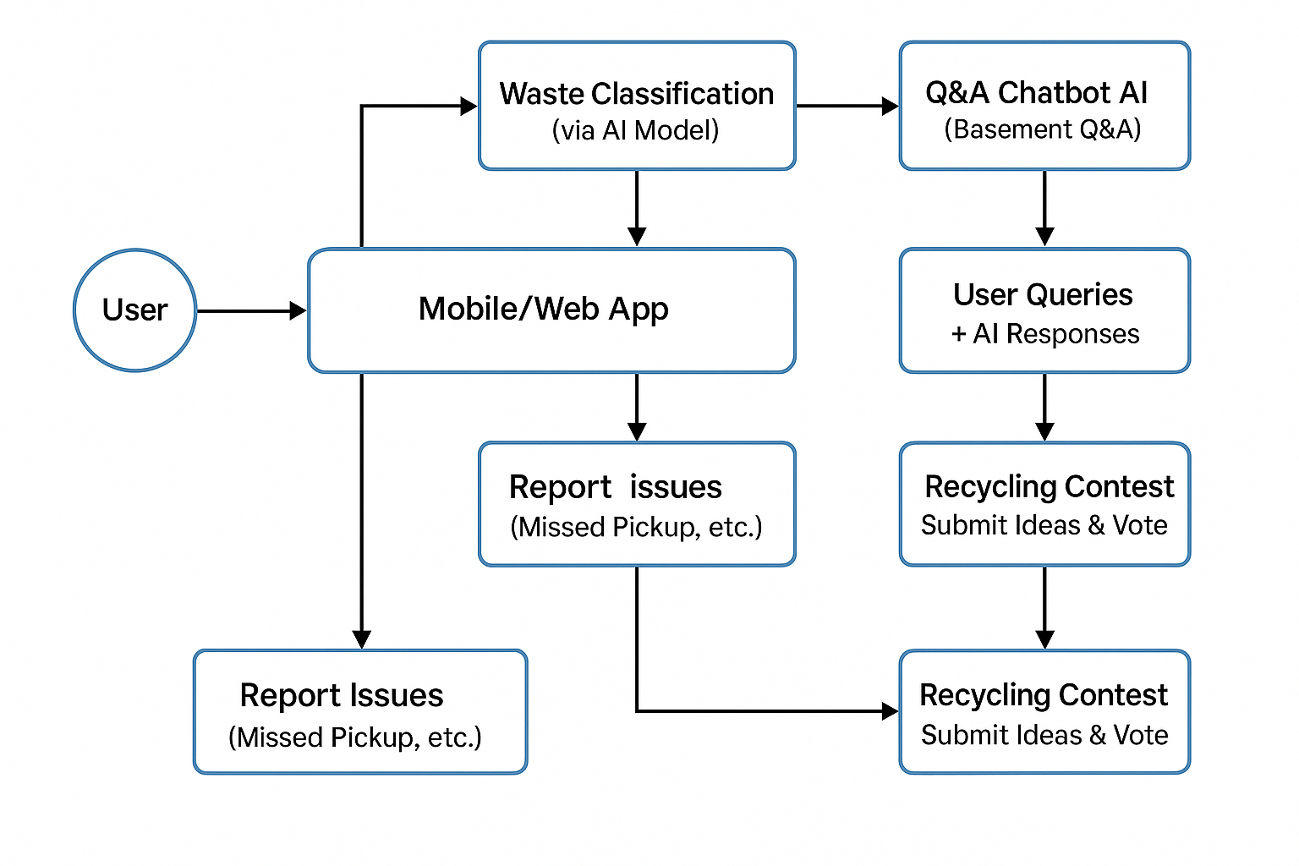
DATA FLOW DIAGRAM

Slide 12
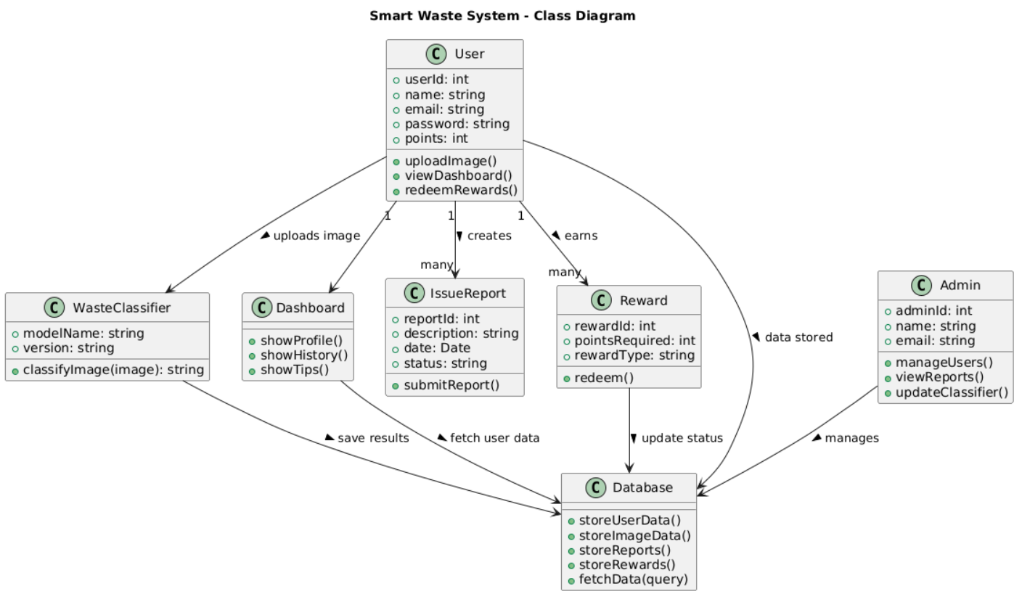
CLASS DIAGRAM

Slide 13
JUSTIFICATION FOR POSITIVITY
Environmental Benefit – Helps reduce pollution by promoting proper waste segregation and recycling.
Use of AI/ML – Ensures accurate and efficient classification of waste images compared to manual sorting.
User Engagement – Reward system motivates people to participate actively in eco-friendly practices.
Community Impact – Simplifies issue reporting and creates awareness about sustainable waste management.
Scalability – Modular design allows easy extension to support more waste categories and future upgrades.
Automation – Reduces manual effort for both users and administrators by providing instant classification results

Slide 14
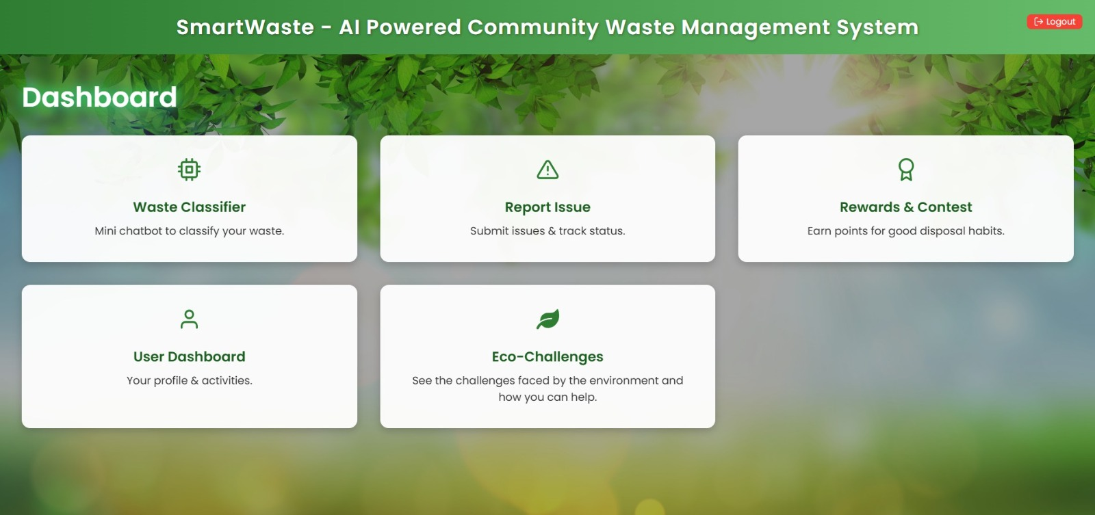
EXPERIMENT RESULTS

Slide 15
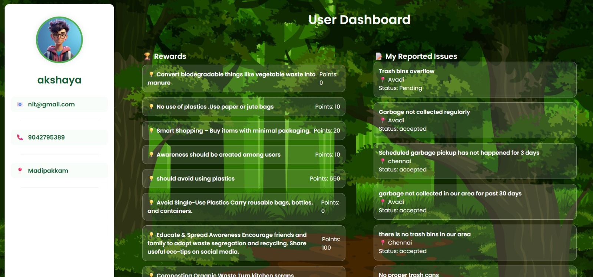
EXPERIMENTAL RESULTS

Slide 16
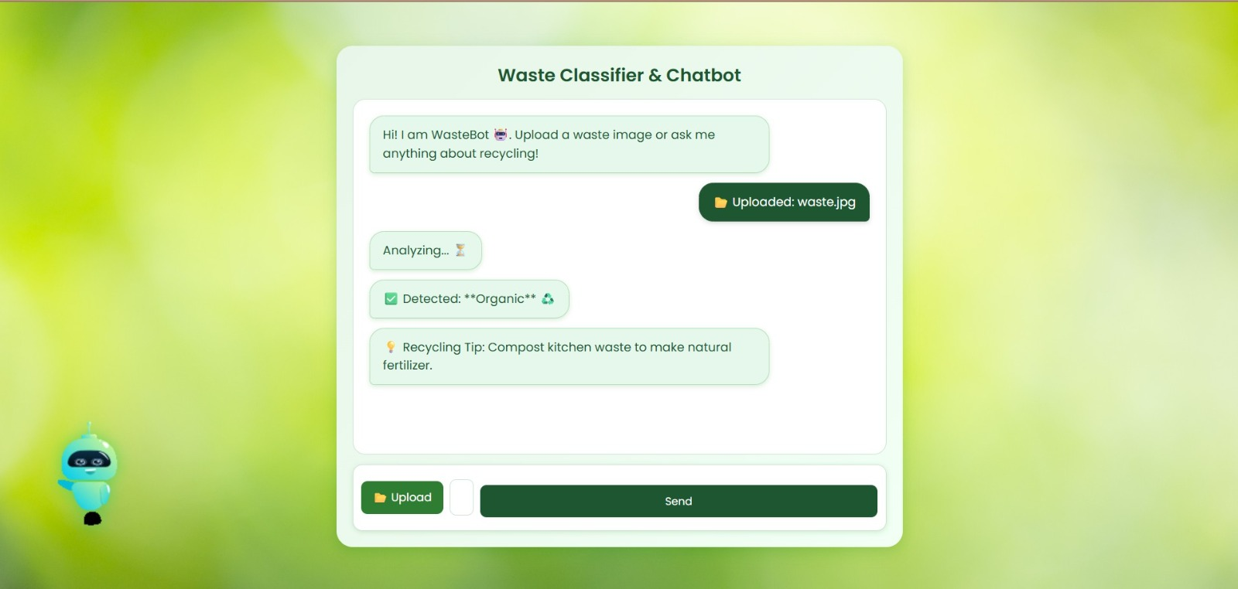
EXPERIMENTAL RESULTS

Slide 17
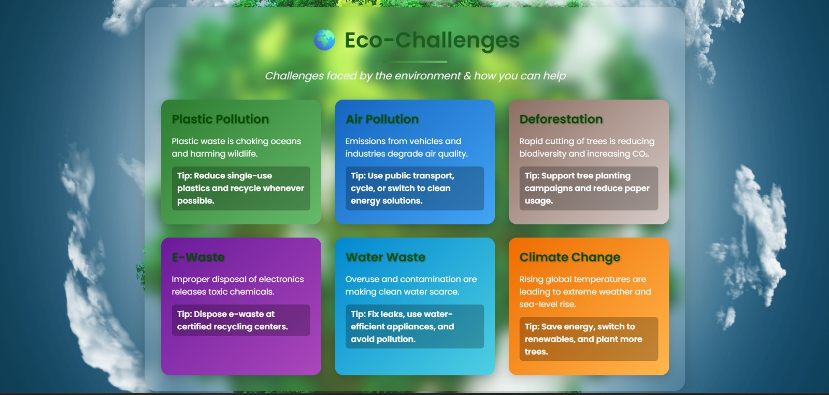
EXPERIMENT RESULTS

Slide 18
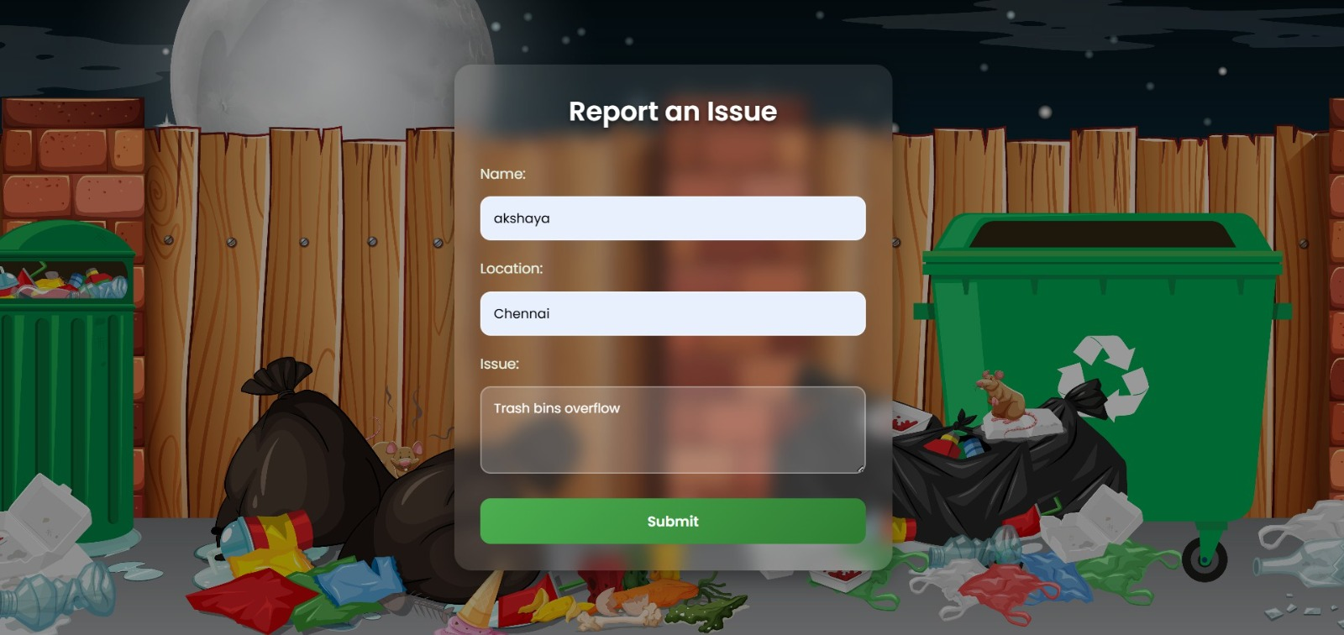
EXPERIMENT RESULTS

Slide 19
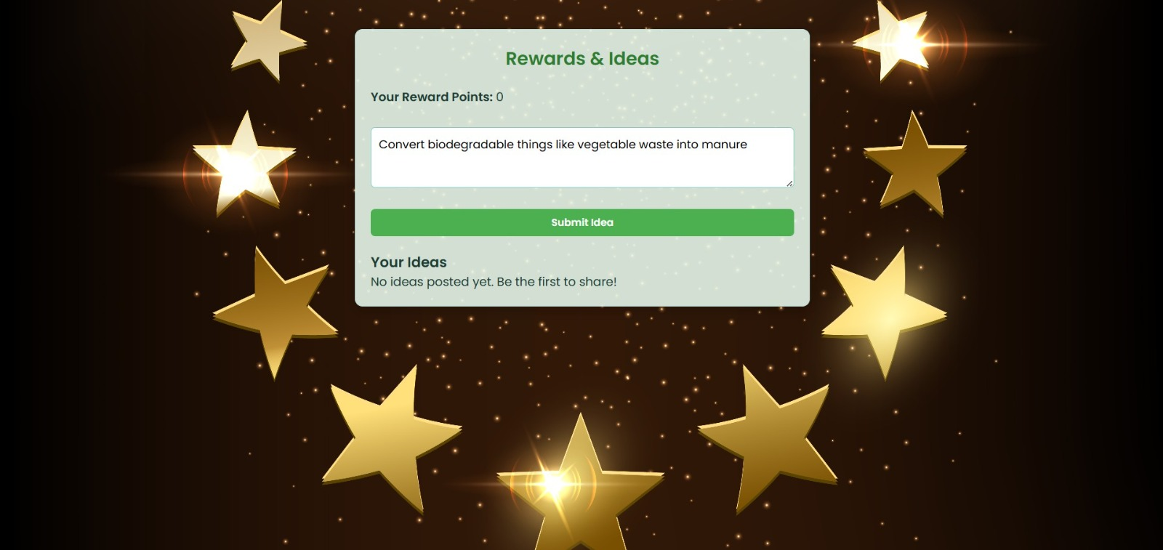
EXPERIMENT RESULTS

Slide 20
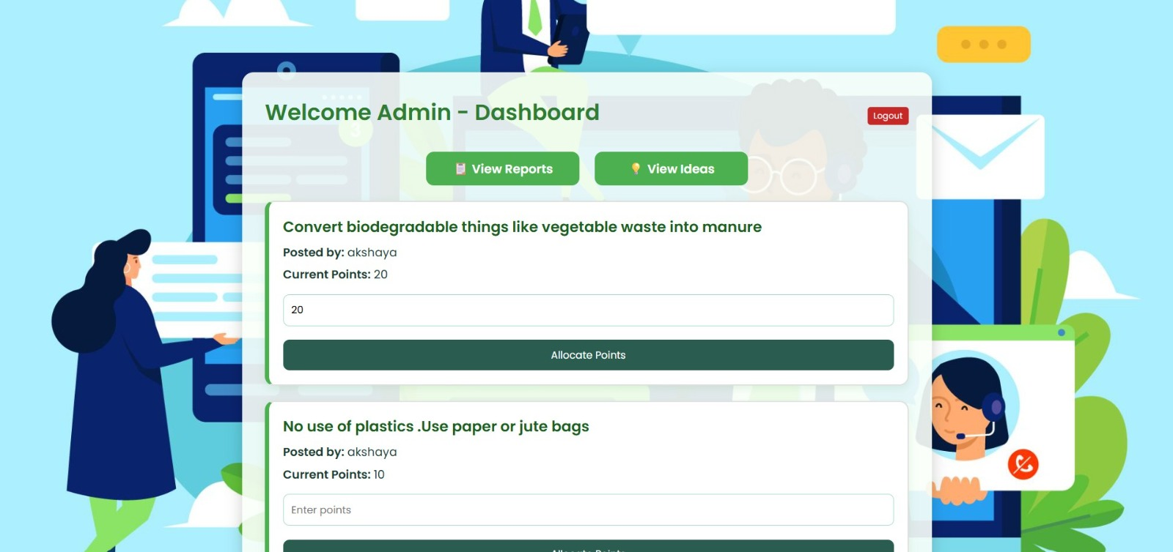
EXPERIMENTAL RESULTS

Slide 21
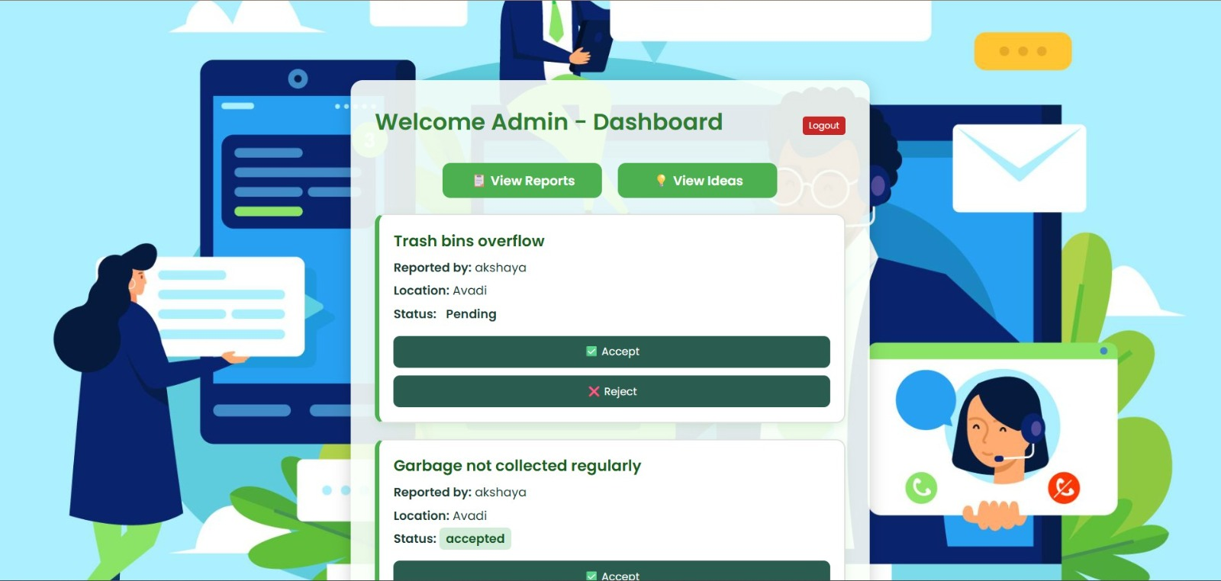
EXPERIMENTAL RESULTS

Slide 22
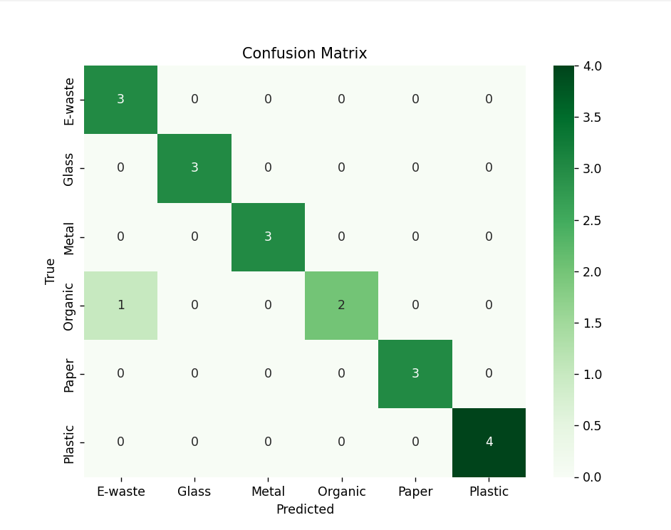
EXPERIMENTAL RESULTS

Slide 23
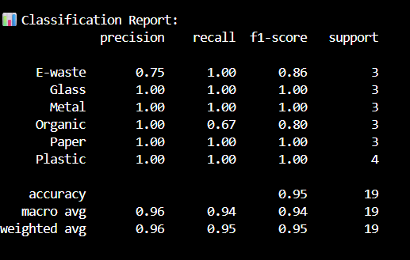
EXPERIMENTAL RESULTS

Slide 24
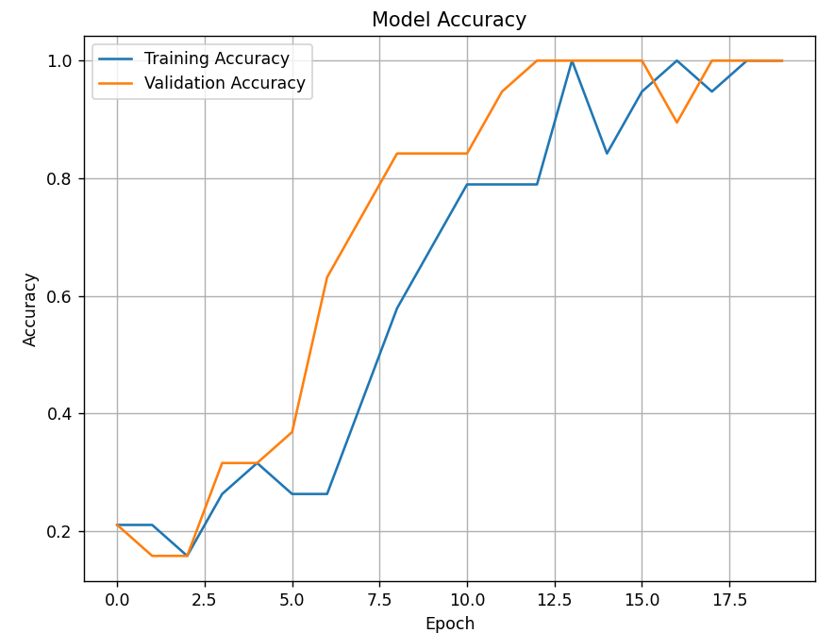
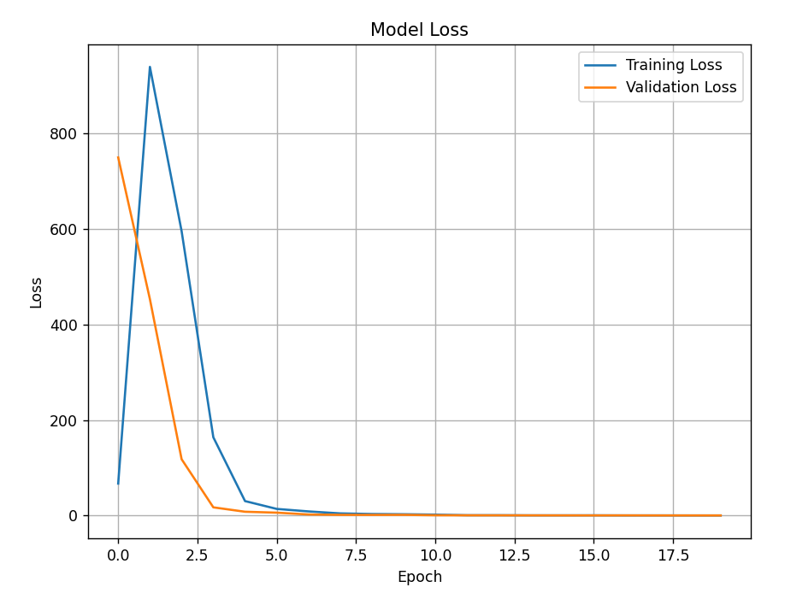
EXPERIMENTAL RESULTS

Slide 25
FUTURE STEPS
The Smart Waste Management System demonstrates how Artificial Intelligence can be effectively applied to solve real-world environmental challenges. The project integrates waste classification using CNN/Mobile Net, a user dashboard for personalized interaction, issue reporting, and a reward-based incentive system. By combining technology with sustainability goals, the system encourages citizens to actively participate in waste segregation, thus supporting cleaner communities and improved recycling processes.
To further enhance the system, the following improvements are planned:
IoT Integration – Connect smart bins with sensors to track fill levels and optimize waste collection routes.
Mobile App Development – Provide Android/iOS apps for broader accessibility.
Model Enhancement – Train with larger and more diverse datasets for higher classification accuracy.
Multi-language Support – Make the system accessible to users in different regions.
Government & NGO Collaboration – Partner with organizations to expand impact and adoption.
Carbon Footprint Tracking – Add analytics to show environmental benefits achieved by users.

Slide 26
CONCULSION
The Smart Waste Management System successfully demonstrates how Artificial Intelligence can support sustainable development by enabling accurate waste classification and encouraging responsible disposal practices. Through features such as a user-friendly dashboard, issue reporting, and a reward-based incentive mechanism, the system not only simplifies waste management but also motivates community participation.
By combining technology with environmental responsibility, this project highlights the potential of smart solutions in reducing pollution, promoting recycling, and building awareness. With future enhancements like IoT integration, mobile app support, and wider adoption, the system can play a vital role in creating cleaner, greener, and smarter cities.

Slide 27
THANK YOU

